Slide 1
Title: Blockchain Technology:

Slide 2
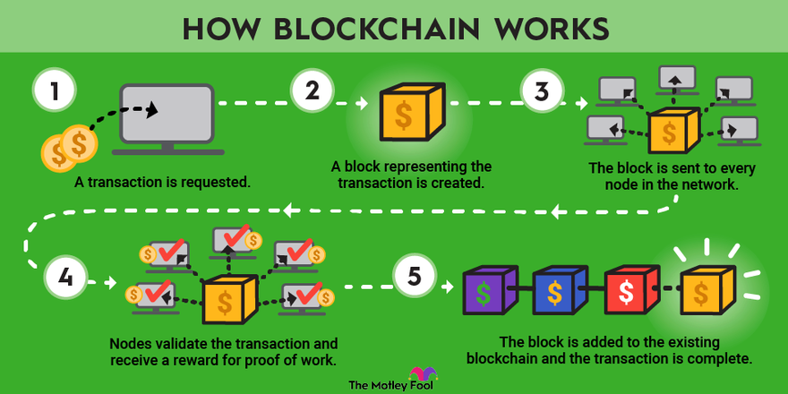
Table of content
Introduction
Core Principles
How Blockchain Works
Application of Blockchain
Challenges and solution
Future Prospects
Conclusion

Slide 3
Introduction
- Blockchain: A decentralized, immutable digital ledger
- Origin: Conceptualized by Satoshi Nakamoto in 2008
- Initially designed for Bitcoin, now with broader applications.

Slide 4
Core Principles
- Decentralization: No central authority
- Transparency: Open and verifiable transactions
- Immutability: Tamper-resistant records
- Cryptographic security: Ensures data integrity

Slide 5
How Blockchain Works
Structure:
- Blocks: Contains multiple transactions
- Transactions: Record of data exchange
- Hashes: Unique identifiers linking blocks
Consensus Mechanisms:
- Proof of Work (PoW)
- Proof of Stake (PoS)

Slide 6
Applications of Blockchain
- Finance: Cryptocurrencies, cross-border payments
- Supply Chain: Traceability, accountability
- Healthcare: Secure medical records, patient privacy
- Government: Secure voting, transparent public records

Slide 7
Challenges and Solutions
- Scalability issues: Layer 2 solutions, sharding
- Energy consumption: PoS, renewable energy sources
- Regulatory challenges: Developing legal frameworks
- Ongoing research: Quantum-resistant cryptography

Slide 8
Future Prospects
- Emerging trends: DeFi, NFTs, Web3
- Integration with IoT and AI
- Potential for revolutionizing various industries

Slide 9
Conclusion
- Blockchain: A transformative technology
- Potential to reshape industries and processes
- Continued innovation and adoption expected

Slide 10
Thank You

